Slide 1
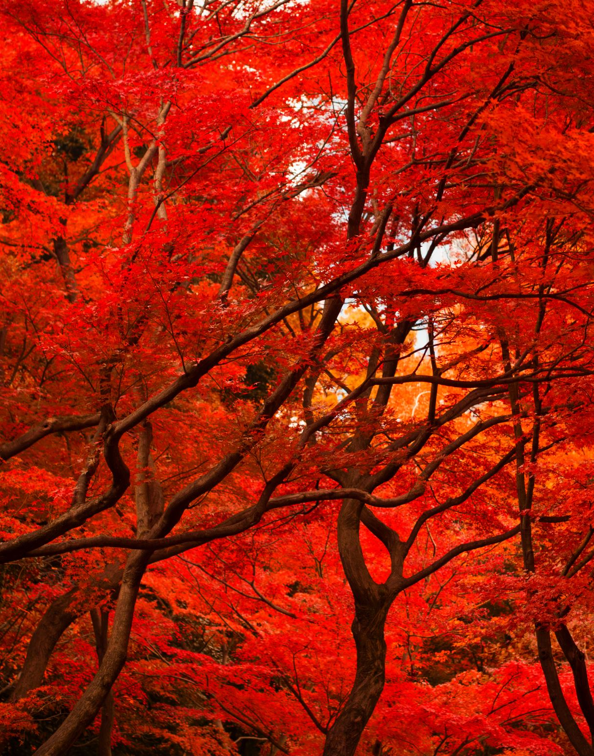
Red Black Trees
Prof. Prateek Vishnoi
Dr. Vipin Kumar

Slide 2
Properties
A red-black tree is a binary search tree that satisfies the following :
Every node is either red or black.
The root is black.
Every leaf (NIL) is black.
If a node is red, then both its children are black.
For each node, all simple paths from the node to descendant leaves contain the same number of black nodes.

Slide 3
Deletion
Delete acc. To BST.
Case 1: If the node to be deleted is RED, DELETE it and EXIT.
Case 2 : If DB is ROOT, remove DB.
Case 3 : If DB’s sibling is BLACK and both its NEPHEW are BLACK
REMOVE DB.
Make sibling RED.
Add BLACK to PARENT.
Case 4 : If DB’s sibling is RED,
SWAP color’s of DB’s parent and DB’s sibling.
Rotate parent in DB’s direction.
Reapply a suitable case.

Slide 4
Deletion
Case 5: If DB’s sibling is BLACK, far nephew is BLACK & near nephew is RED :
SWAP colors of DB’s siblings & DB’s near NEPHEW.
ROTATE DB’s sibling in opposite direction of DB.
Apply Case 6.
Case 6 : If DB’s sibling is BLACK & far nephew is RED.
SWAP colors of DB’s parent & DB’s sibling.
ROTATE DB’s parent in DB’s direction.
Change color of RED nephew to BLACK.
REMOVE DB.

Slide 5
Delete 50
40
40
20
60
Acc. To BST
20
60
10
30
50
80
10
30
N
80
70
90
70
90
99
99

Slide 6
Delete 50
40
40
20
60
20
60
Case 4
SWAP color
10
30
N
80
10
30
N
80
70
90
70
90
99
99

Slide 7
40
40
20
60
20
80
Rotate the parent in DB’s direction
10
30
N
80
10
30
60
90
70
99
70
90
N
99

Slide 8
40
40
Case 3
20
80
20
80
10
30
60
90
10
30
60
90
70
99
70
99
N

Slide 9
Delete 20
40
40
20
80
30
80
BST Deletion
10
30
60
90
10
30
60
90
70
99
70
99

Slide 10
Delete 20
40
40
30
80
30
80
Delete leaf 30
10
30
60
90
10
N
60
90
70
99
70
99

Slide 11
Delete 20
40
40
30
80
Case 3
30
80
10
N
60
90
10
60
90
70
99
70
99

Slide 12
Delete 20
40
40
30
80
Case 3
30
80
10
60
90
10
60
90
70
99
70
99

Slide 13
Delete 20
40
40
30
80
Case 2
30
80
10
60
90
10
60
90
70
99
70
99

Slide 14
Delete 99
40
40
30
80
Case 1
30
80
10
60
90
10
60
90
70
99
70

Slide 15
Delete 90
40
40
30
80
BST deletion
30
80
10
60
90
10
60
N
70
70

Slide 16
Delete 90
40
40
30
80
Case 5
30
80
10
60
N
10
60
N
70
70

Slide 17
Delete 90
40
40
30
80
30
80
Case 5
10
60
N
10
70
N
70
60

Slide 18
Delete 90
40
40
30
80
Case 6
30
80
10
70
N
10
70
N
60
60

Slide 19
Delete 90
40
40
30
80
30
70
Case 6
10
70
N
10
60
80
60
N

Slide 20
Delete 90
40
40
30
70
30
70
Case 6
10
60
80
10
60
80
N

Slide 21
Delete 40
40
60
BST Deletion
30
70
30
70
10
60
80
10
60
80

Slide 22
Delete 60
60
60
Case 3
30
70
30
70
10
N
80
10
80

Slide 23
Delete 60
60
60
Case 3
30
70
30
70
10
80
10
80

Slide 24
Delete 60
60
70
30
70
BST Deletion
30
70
10
80
10
80

Slide 25
Delete 70(internal node)
70
70
30
70
BST Deletion
30
80
10
80
10
80

Slide 26
Delete 80(leaf node)
70
70
30
80
Case 1
30
80
10
80
10

Slide 27
Delete 70
70
80
BST Deletion
30
80
30
80
10
10

Slide 28
Delete 80(leaf node)
70
80
BST Deletion
30
80
30
N
10
10

Slide 29
Delete 80(leaf node)
80
30
Case 6
10
80
30
N
10
N

Slide 30
Delete 80(leaf node)
30
30
Case 6
10
80
10
80
N

